Slide 1
IEEE Project Competition
Week 2: Microcontrollers

Slide 2
Reminders
Please be an registered IEEE members by week 3! We will be check for it, if your not sure ask us any questions you have and we will help you.
Groups aren’t 100% final today but I will be putting everyone in groups and if someone wants to join later on they must be a IEEE member.
The MSP430’s you can’t keep (sorry!).
Be careful with the MSP430’s and all electronics in general.

Slide 3



Meet the Team
Matias Guillen
Erik Siegman
Yousef Awad
Project Chair
Sophomore - Electrical Engineering
Internal Project Competition - Lead
Contact: vector8925
Project Committee
Sophomore - Computer Engineering
Internal Project Competition - Sub-Lead
Contact: eriks0527
Project Committee
Sophomore - Computer Engineering
Internal Project Competition - Sub-Lead
Contact: quil180

Slide 4

Meet the Team
Tino Hernandez
Project Committee
Sophomore - EE/CS/CPE/Delusion
Internal Project Competition - Sub-Lead
Contact: vjmuzik

Slide 5
This Meeting’s Agenda
Overview of MSP430 microcontrollers
Setting up the Arduino IDE
Basic C++ programming concepts
Interfacing with microcontroller pins
Demonstration of servo/motor control
Finalize Teams

Slide 6
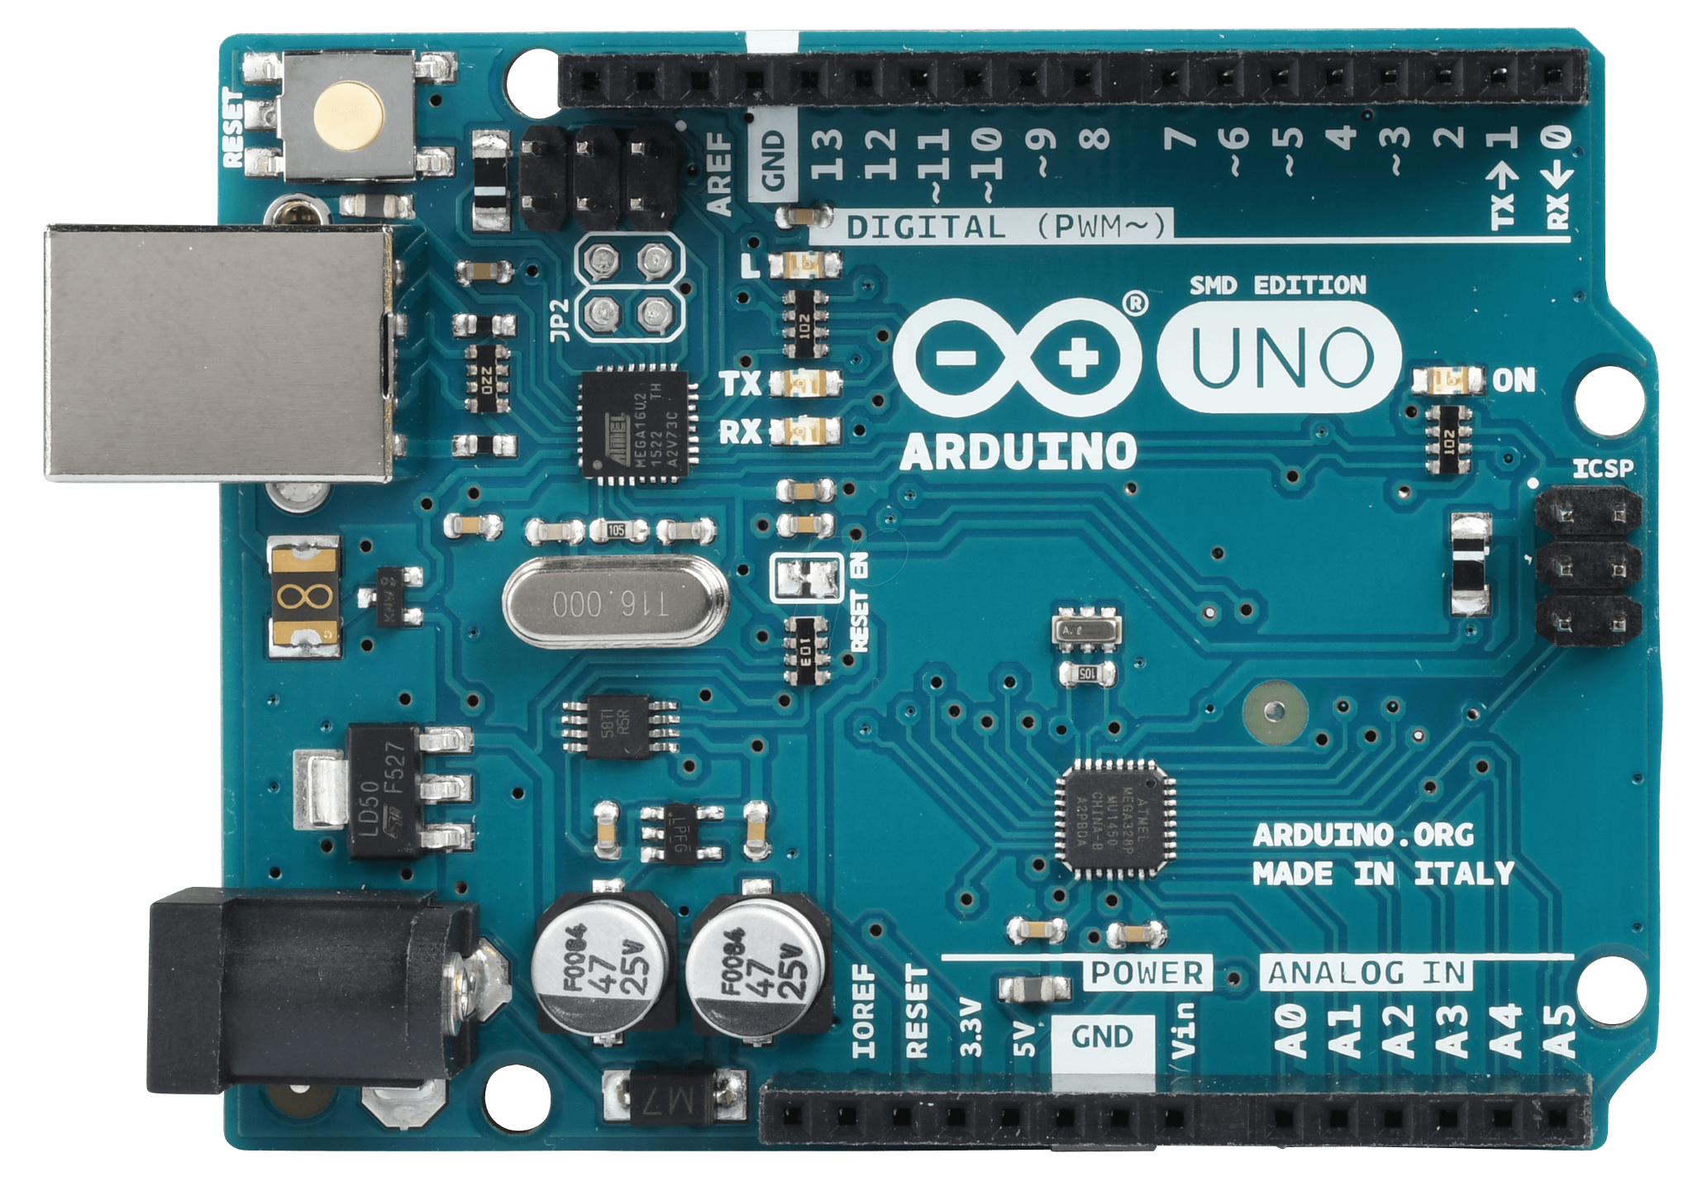
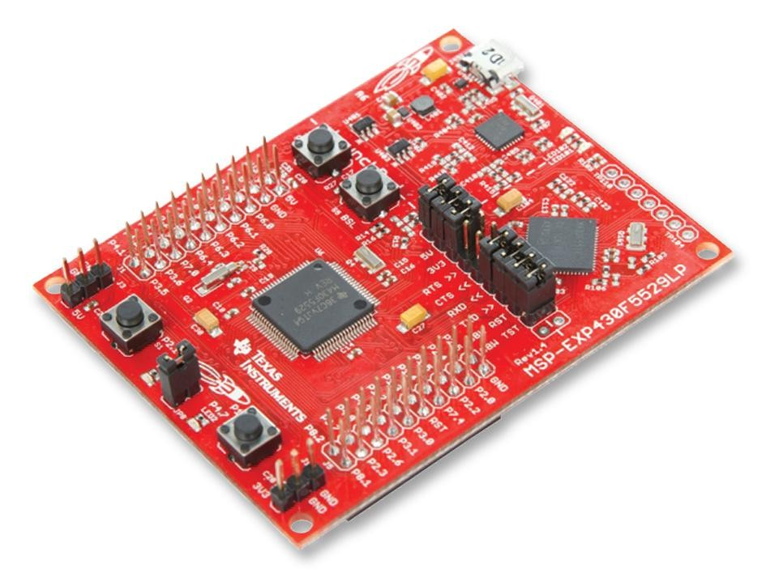
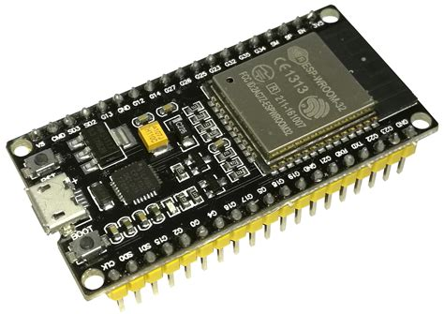
What is a Microcontroller
Definition:
A microcontroller is a small, low-cost computer on a single integrated circuit (IC) that includes a processor, memory, and input/output (I/O) peripherals.
Why Use Microcontrollers?
Control Systems: Commonly used in embedded systems for controlling specific functions.
Cost-Effective: Inexpensive solution for automation and small-scale computing.
Versatility: Widely used in consumer electronics, automotive, industrial control, robotics, and more.

Slide 7
Arduino IDE
Why Use Arduino IDE for MSP430?
User-Friendly Interface: Simple, intuitive environment for beginners and experienced users.
Cross-Platform Compatibility: Works on Windows, macOS, and Linux.
Community Support: Large user base with extensive tutorials and forums.
Integrated Tools: Built-in code editor, compiler, and serial monitor.
Go to https://www.arduino.cc/en/software and download the latest version (2.3.2)

Slide 8
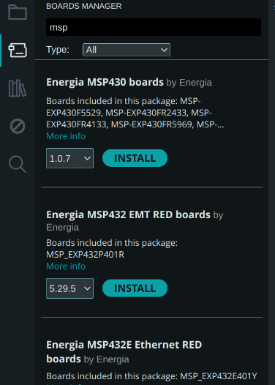
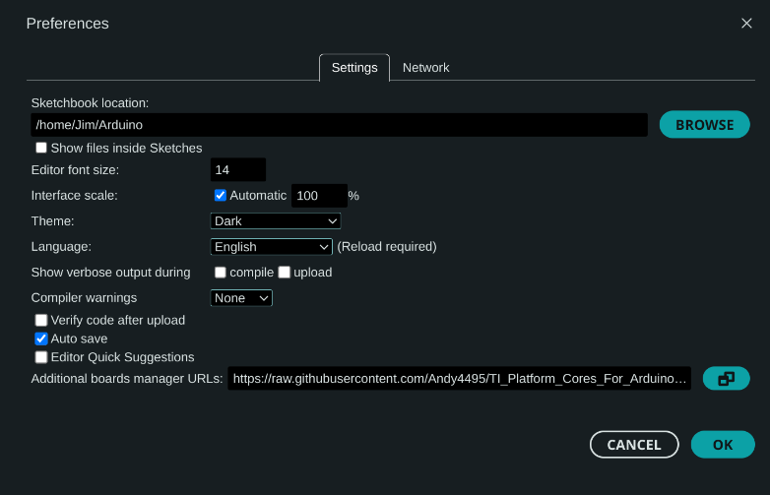
Arduino IDE
https://raw.githubusercontent.com/Andy4495/TI_Platform_Cores_For_Arduino/main/json/package_energia_optimized_index.json

Slide 9
Install Drivers
https://www.ti.com/tool/download/MSPDS-USB-DRIVERS/1.0.1.2
Make an account and download the proper drivers, or download the file in Discord
Open the file and follow the prompt to install

Slide 10
C++
What is C++?
A powerful, general-purpose programming language.
Widely used for system programming, game development, embedded systems, and applications requiring high performance.
C++ Basics
Variables: Named storage for data that your program can manipulate.
int - Integer numbers (e.g., int age = 21;)
float - Floating-point numbers (e.g., float temperature = 98.6;)
char - Single characters (e.g., char grade = 'A';)
bool - Boolean values (true or false) (e.g., bool isOpen = true;)
string - Sequence of characters (requires #include <string>) (e.g., string name = "Alice";)
Operators
Arithmetic Operators: +, -, *, /, % (modulus)
Comparison Operators: ==, !=, <, >, <=, >=
Logical Operators: && (and), || (or), ! (not)

Slide 11
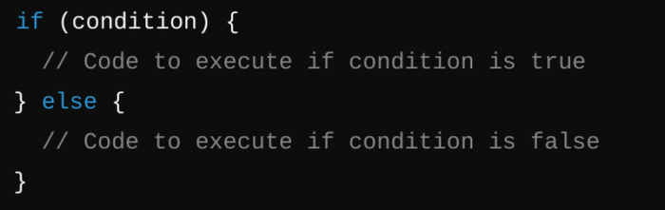
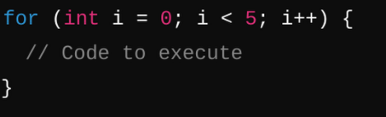
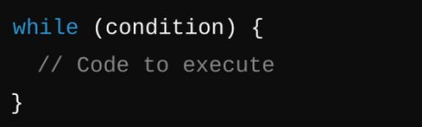
C++
Conditionals
A
Loops
For loop: repeats a specified number of times
While loop: repeats while a condition is true

Slide 12
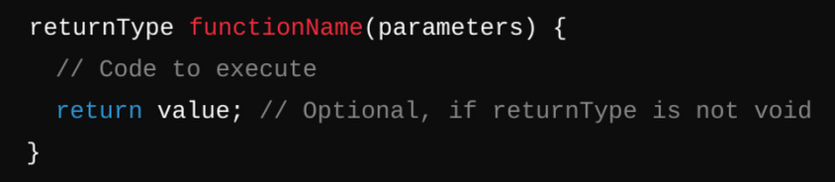
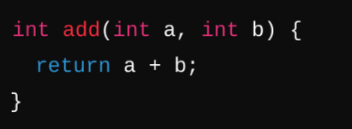
C++
Functions: Reusable blocks of code designed to perform specific tasks.
Syntax:
Example:

Slide 13
C++ for Microcontrollers using Arduino
How Arduino Programming Differs from Standard C++:
Simplified Setup: No need for a main() function; instead, use setup() and loop():
setup(): Runs once at the start to initialize settings (e.g., pin modes, serial communication).
loop(): Repeatedly executes as long as the board is powered.
Built-in Functions and Libraries:
Arduino provides built-in functions for hardware interaction (e.g., digitalRead(), digitalWrite(), analogRead(), delay()).
Many pre-written libraries make complex tasks simpler (e.g., controlling motors, handling communication protocols).

Slide 14
C++ for Microcontrollers using Arduino
Key Functions:
setup() Function:
Purpose: Runs once when the microcontroller is powered on or reset.
Use: Initialize settings (e.g., setting pin modes, starting serial communication).
loop() Function:
Purpose: Runs continuously after setup() is complete.
Use: Main body of the program; repeatedly executes the code inside, allowing the microcontroller to perform tasks over and over.
pinMode(pin, mode) Function:
Purpose: Configures a specific pin to behave as either an input or an output.
Parameters:
pin: The number of the pin to set (e.g., 13).
mode: INPUT, OUTPUT, or INPUT_PULLUP.

Slide 15
C++ for Microcontrollers using Arduino
Key Functions:
digitalWrite(pin, value) Function:
Purpose: Sends a HIGH or LOW signal to a digital pin.
Parameters:
pin: The number of the pin to write to (e.g., 13).
value: HIGH (turns the pin on) or LOW (turns the pin off).
digitalRead(Pin) Function:
Purpose: Reads the state of a specified digital input pin.
Parameters:
pin: The number of the digital pin you want to read (e.g., 2).
Returns:
HIGH (1) if the pin is receiving a voltage signal.
LOW (0) if the pin is not receiving a voltage signal.
delay(milliseconds) Function:
Purpose: Pauses the program for a specified amount of time.
Parameters:
Milliseconds: Time to wait in milliseconds (1000 milliseconds = 1 second).

Slide 16
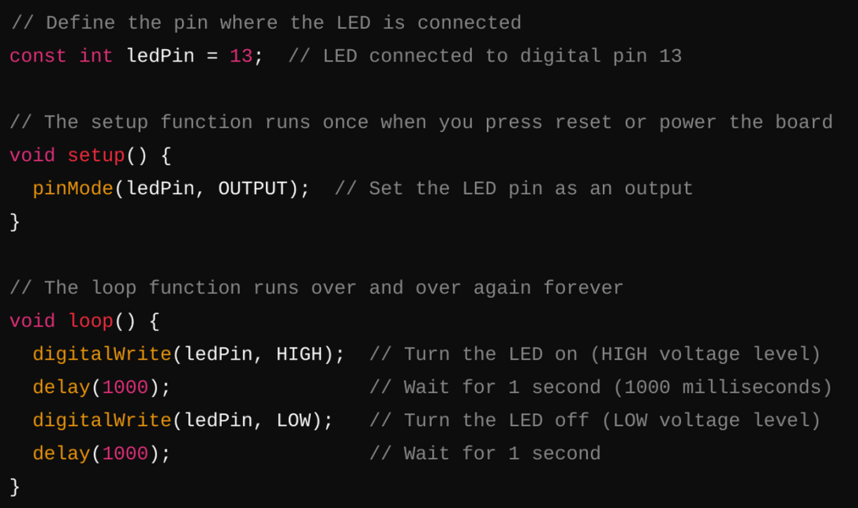
Basic Arduino Program
Key Points:
pinMode(ledPin, OUTPUT): Configures the LED pin as an output so it can send a signal.
digitalWrite(ledPin, HIGH): Sends a HIGH signal (5V or 3.3V depending on your board) to turn the LED on.
digitalWrite(ledPin, LOW): Sends a LOW signal (0V) to turn the LED off.
delay(1000): Pauses the program for 1000 milliseconds (1 second) between turning the LED on and off.
What You'll See:
The LED connected to pin 13 will blink on and off, with a 1-second interval between each state change.

Slide 17
Running an Arduino Program
Connect your MSP430 to the computer
Select the board from the dropdown
Use to check if code will run
Send code to microcontroller

Slide 18
C++ for Microcontrollers using Arduino
SO MUCH MORE
Classes: C++ is an object oriented programming language, so classes allow you to organize large chunks of code that are repeated
Libraries: many libraries exist that add functions such as easier communication with servos, interpreting gyroscope signals, etc

Slide 19
Servo Activity
What is a Servo Motor?
A servo motor is a rotary actuator that allows for precise control of angular position, speed, and acceleration.
Commonly used in robotics, RC vehicles, and other applications where precise movement is required.
Wiring the Servo Motor:
3 Wires:
Red Wire: Connect to 5V (power).
Brown/Black Wire: Connect to GND (ground).
Orange/Yellow Wire: Connect to a PWM-capable digital pin (e.g., pin 9).
Library for Servo Control:
Use the built-in Arduino Servo library for easy control.
Provides functions to attach the servo to a pin, set its position, and detach it when done.

Slide 20
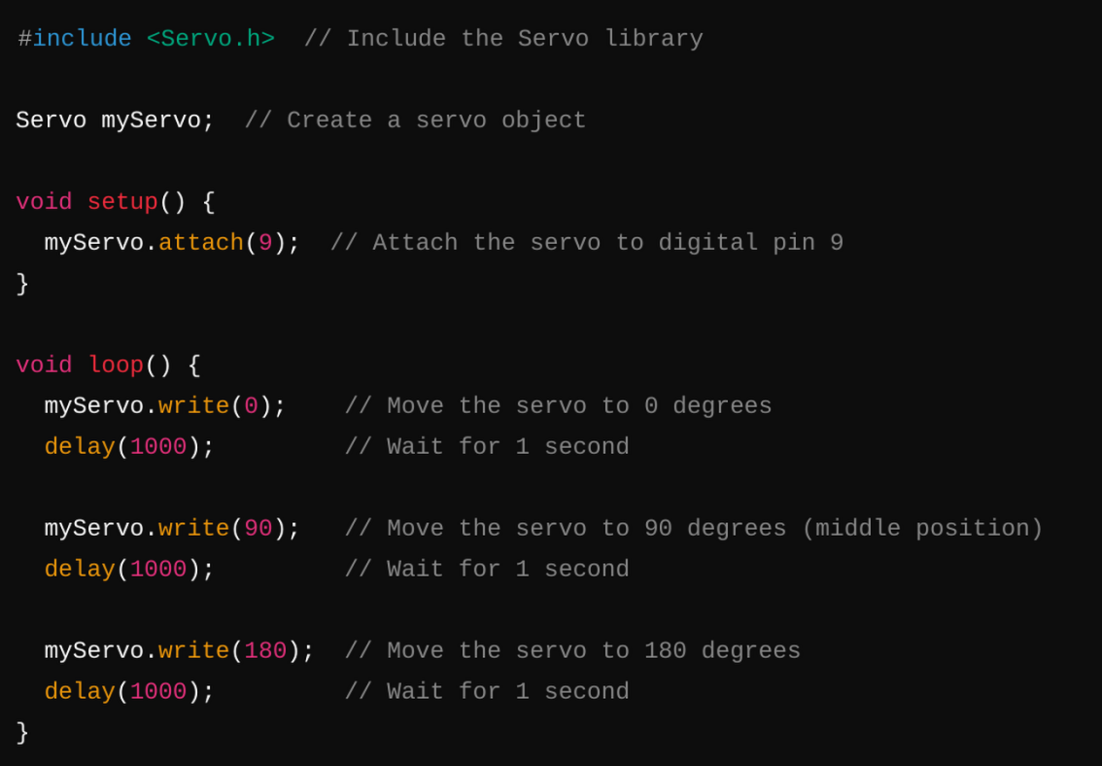

Slide 21
Serial Communication
What is Serial Communication?
Purpose: Allows the Arduino to communicate with a computer or other devices.
Use Case: Debugging, sending data to a serial monitor, communicating with other devices (e.g., sensors, modules).
Why Use Serial Output?
Debugging: Print messages to the serial monitor to check variable values, program flow, and detect errors.
Data Logging: Send sensor readings or other data to a computer for analysis.
Device Communication: Interface with serial peripherals like GPS modules, Bluetooth modules, and other microcontrollers.
Key Serial Output Functions:
Serial.begin(baudRate) Function:
Purpose: Initializes serial communication at a specified baud rate (speed).
Parameters:
baudRate: Speed of communication in bits per second (e.g., 9600).

Slide 22
Serial Communication
Serial.print(data) Function:
Purpose: Sends data to the serial port as human-readable text.
Parameters:
data: The data to print (can be a string, variable, or expression).
Serial.println(data) Function:
Purpose: Similar to Serial.print(), but adds a newline character after printing.
Parameters:
data: The data to print (e.g., strings, variables, or expressions).

Slide 23
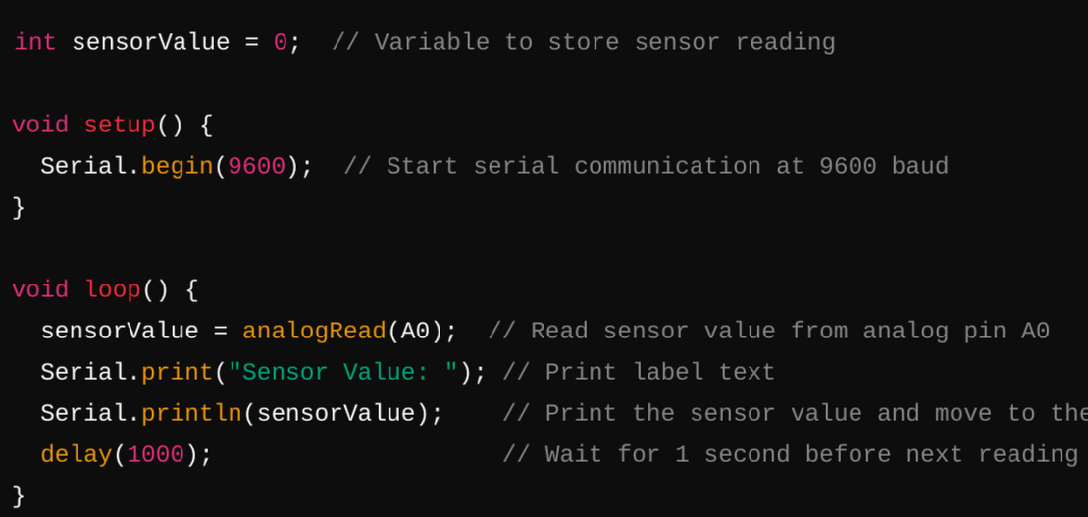
Serial Communication
Explanation:
Serial.begin(9600): Initializes serial communication.
Serial.print(): Prints text to label the output.
Serial.println(): Prints the sensor value followed by a newline.
Result: Displays continuous sensor readings every second on the serial monitor.
Key Points:
Essential for Debugging: Easily monitor what the microcontroller is doing.
Start with Serial.begin(): Always initialize serial communication in setup().
Use print vs. println: Choose based on whether you need a new line after printing.
Serial communication can be used to talk to gyroscopes, gps, bluetooth, and so much more

Slide 24
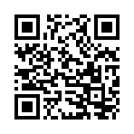
Signup Form

Slide 25
Timeline and Important Dates
Weekly Meetings - Estimated Timeline (Starting September 16th)
Week 1 | Week 2 | Week 3 | Week 4 | Week 5
Introduction | Microcontrollers | Fusion 360/Solidworks | KiCAD | Soldering/Prototyping

Slide 26
Next Week’s Session:
CAD (Fusion360/Solidworks) workshop.
IEEE membership check.
Next session will be on Monday, September 30

